Slide 1

Group Name: Data detectives
Step Presentation #2
AIRLINE
PRICE
PREDICTION

Slide 2
AGENDA
Recap
Objective
Project Lifecycle
Project Timeline
Challenges
Introduction to New Dataset
Insights from the New Dataset
What’s next?

Slide 3
RECAP
We started working on a Demo Dataset.
We completed EDA on our demo dataset.
We created a demo dashboard.
We created our model and did model evaluation on our demo dataset.
We started using Selenium to fetch the latest data from Kayak to keep our model up-to-date.

Slide 4

RECAP: Why we chose Selenium?
Interacts with Web Pages like a Real User
Supports Multiple Browsers
Automates Complex Workflows
Bypasses Some Anti-Scraping Measures
Handles CAPTCHA and ReCAPTCHA
Large Community and Support

Slide 5

OUR OBJECTIVE
Our goal is to predict future airline ticket prices using past data. We'll analyze historical prices, flight dates, number of stops, and other relevant factors to train our machine learning model.
This will help travelers understand price trends and plan trips at the best times to save money.

Slide 6
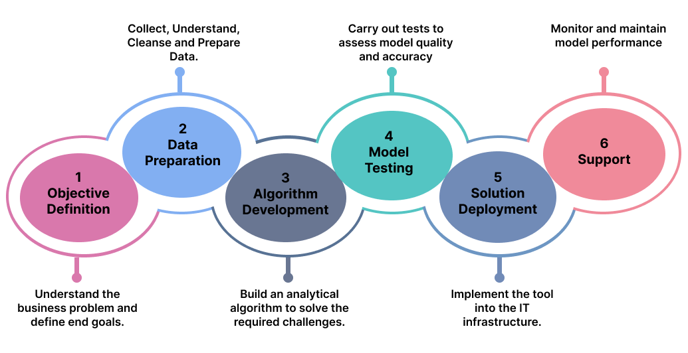
PROJECT LIFECYCLE

Slide 7
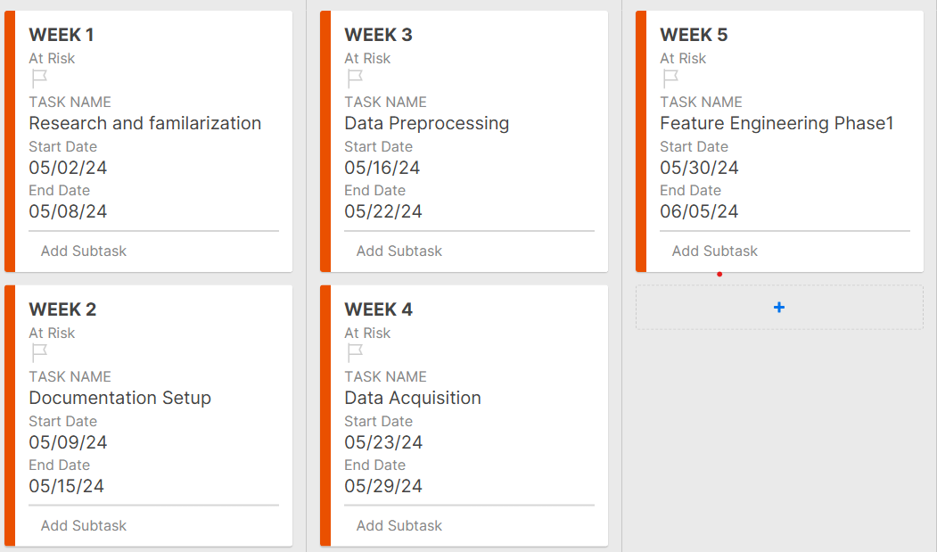


PROJECT TIMELINE
WEEK 1 -5

Slide 8
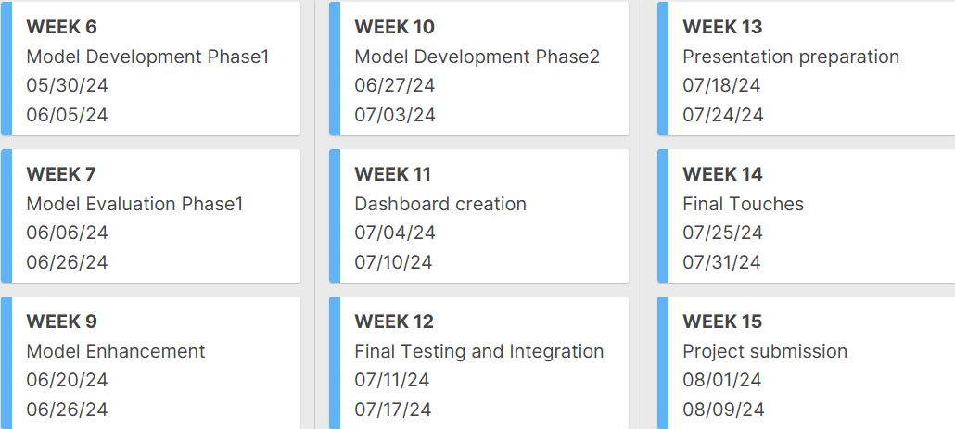

PROJECT TIMELINE
WEEK 6 -15

Slide 9



Our Challenges so Far
Skyscanner was our initial choice for web scraping.
However, Skyscanner flagged scraping as robotic, disrupting data retrieval.
We transitioned to Kayak for its more tolerant scraping policies
Benefits of using Kayak:
Reliable data extraction.
Avoidance of robotic detection issues.
Smooth transition with minimal downtime.

Slide 10


Our New Dataset is Ready

Slide 11

LET’S DIVE INTO THE DETAILS OF OUR NEW DATASET
18 KEY FEATURES
Airline
Source
Destination
Departure
Arrival
Number of Stops
Class
Stopover_1_Time
Stopover_1_Airport
Stopover_2_Time
Stopover_2_Airport
Stopover_3_Time
Stopover_3_Airport
Total_Stopover_Time
Operated
Date
days_left
Price in CAD
E

Slide 12
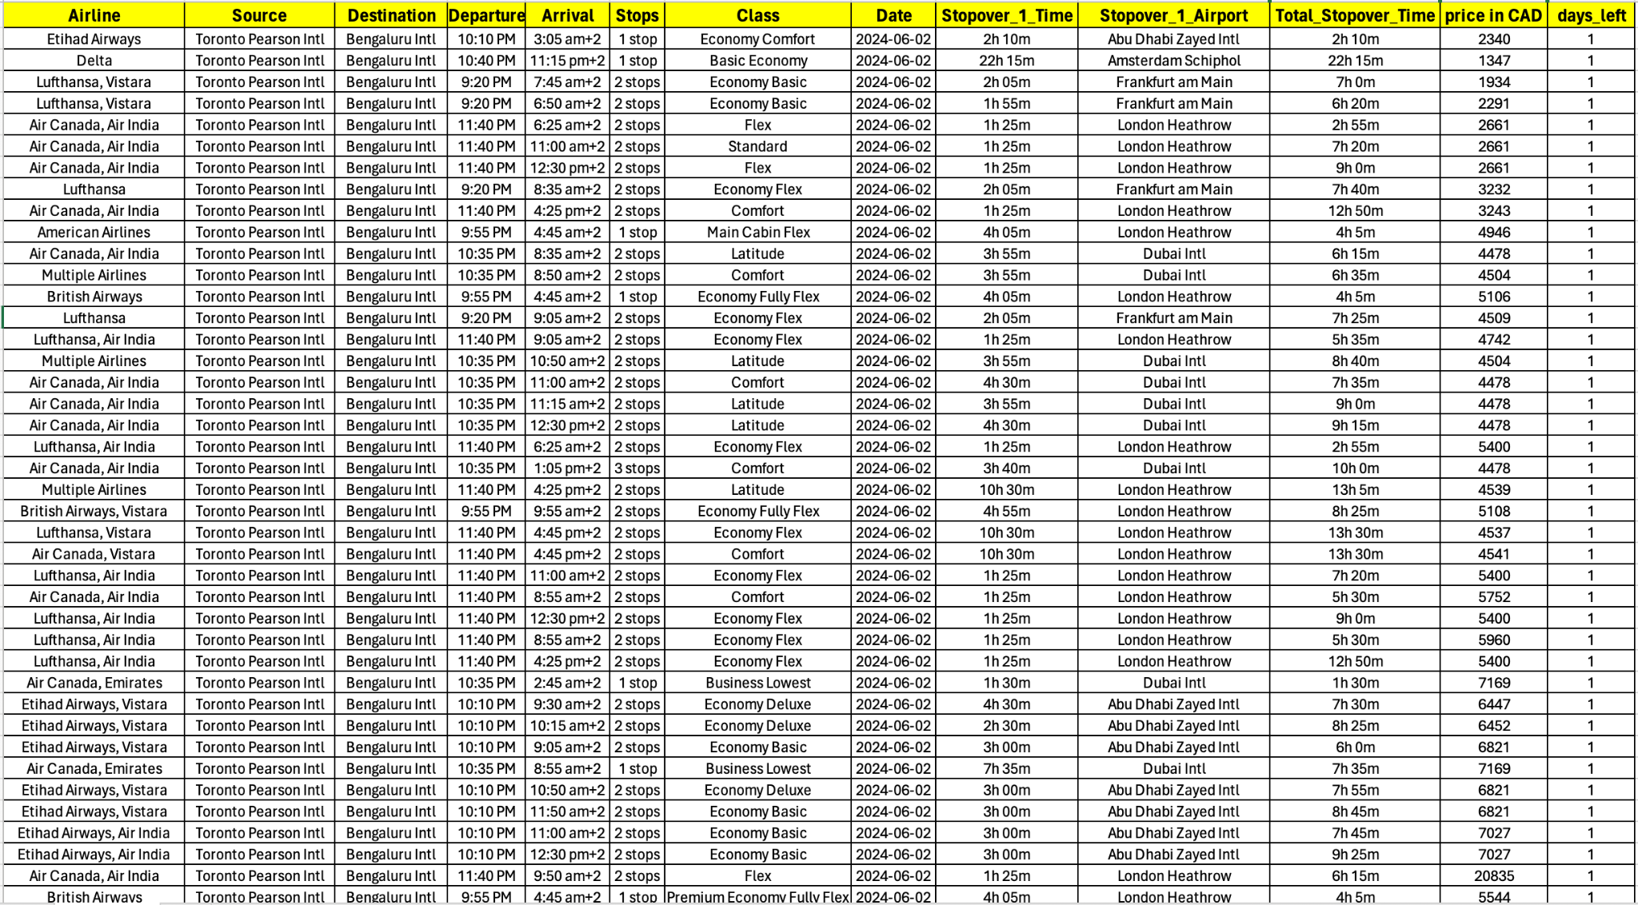
Our New Dataset
Features

Slide 13

Let's Jump Into some fun part!

Slide 14
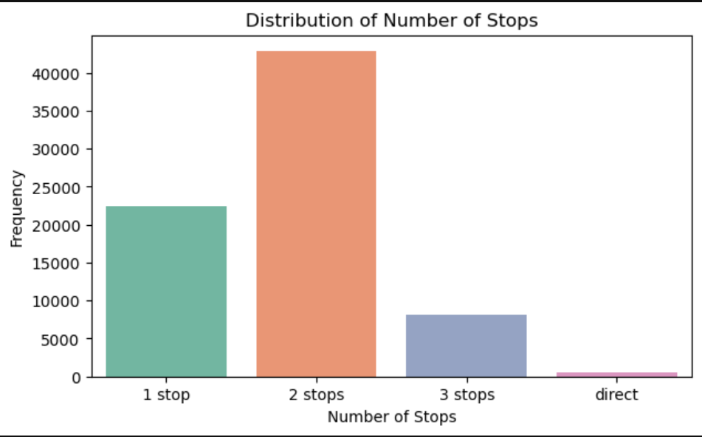
INSIGHTS FROM THE NEW DATASET
The Univariate analysis on Number of Stops shows the majority of flights have either 1 or 2 stops, with 2 stops being the most frequent.

Slide 15
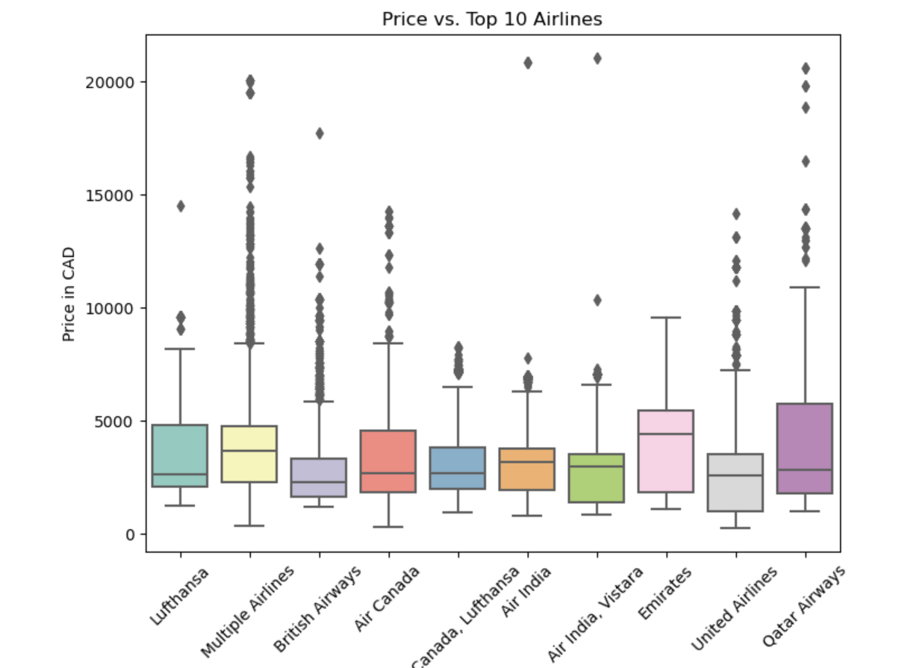
INSIGHTS FROM THE NEW DATASET
This box plot makes it easy for us to detect outliers.

Slide 16
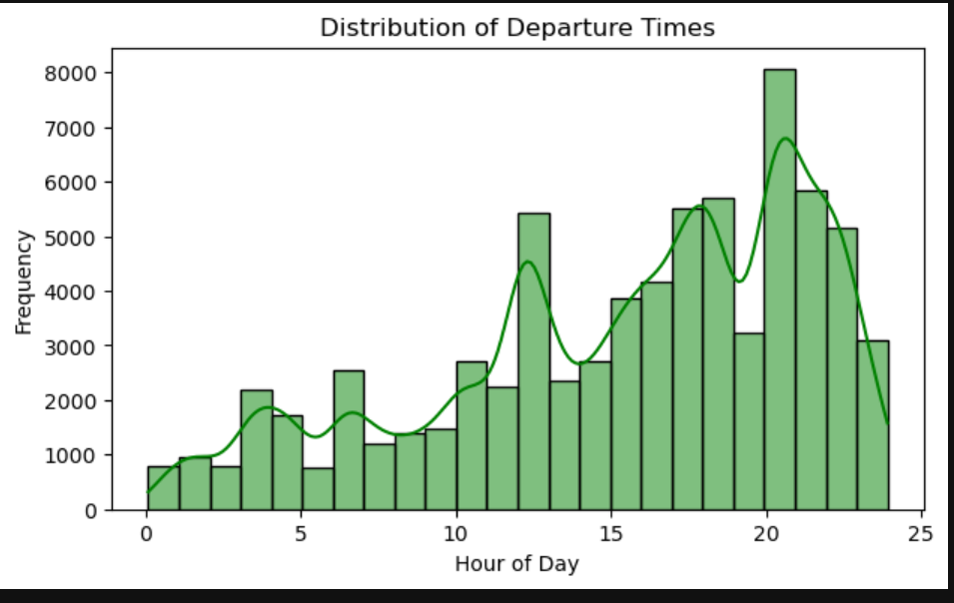
INSIGHTS FROM THE NEW DATASET
The highest peak around 8 PM indicates a preference for night departures, which could be convenient for customers.

Slide 17
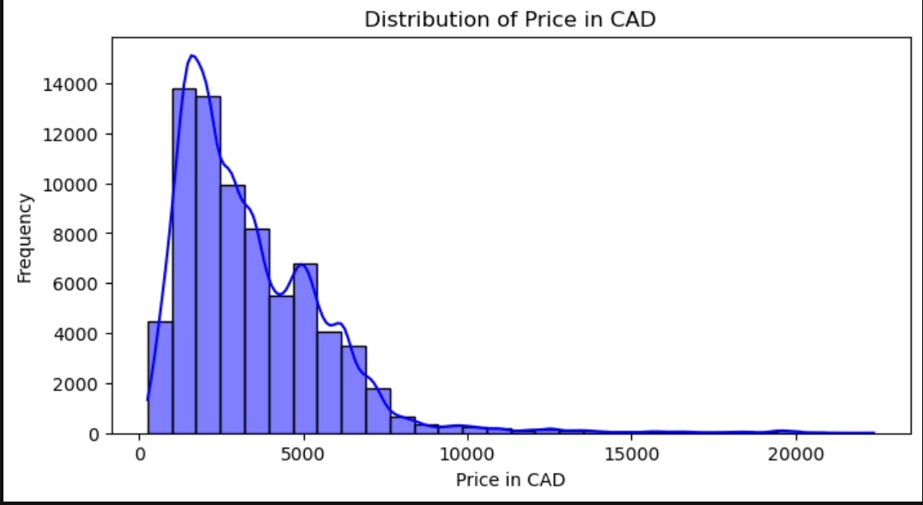
INSIGHTS FROM THE NEW DATASET
The price distribution is right-skewed which means that the majority of the flight prices are relatively low

Slide 18
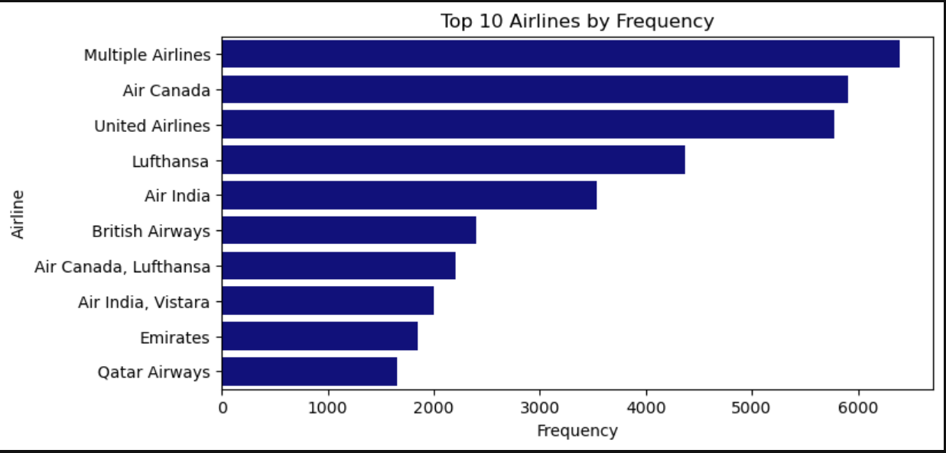
INSIGHTS FROM THE NEW DATASET

Slide 19
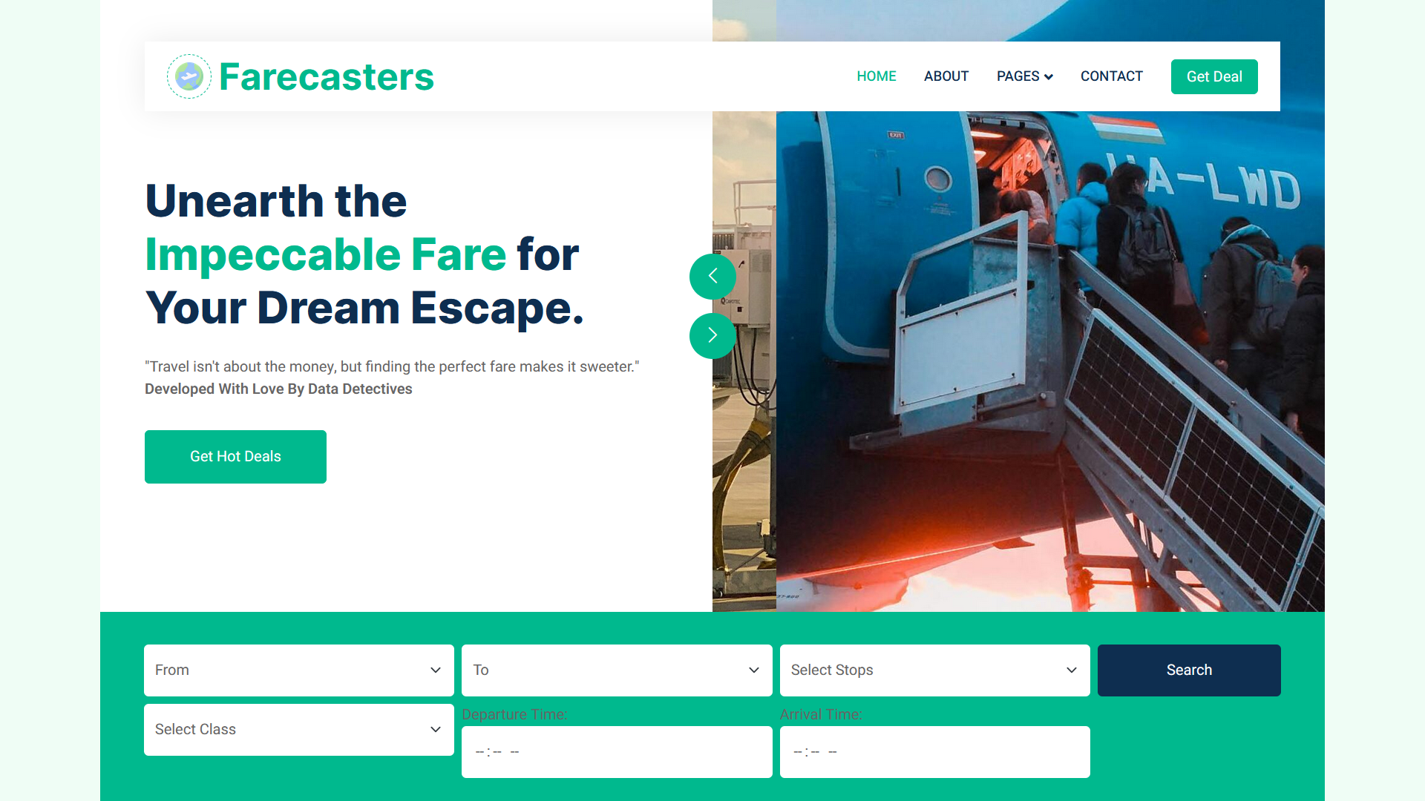
MODEL DEPLOYMENT

Slide 20
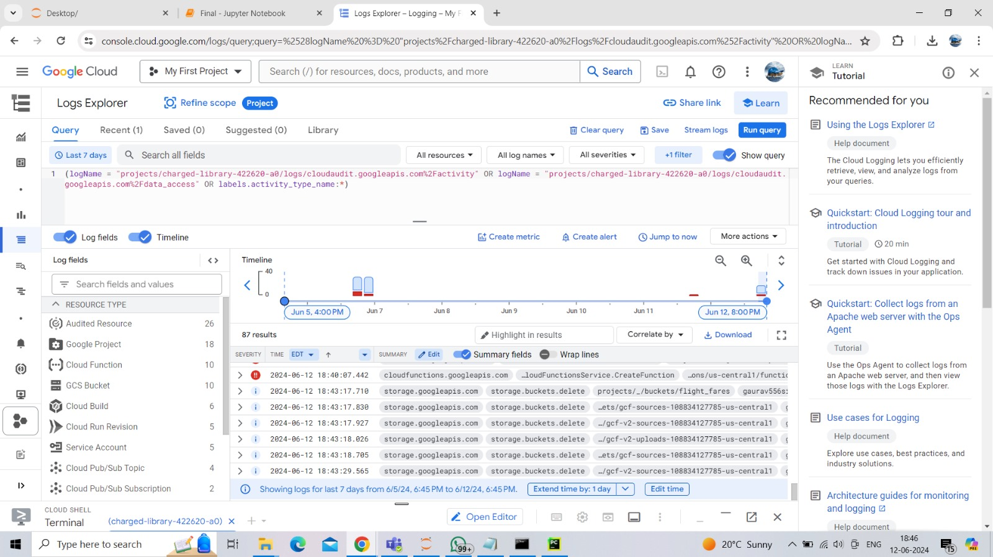
GOOGLE CLOUD PLATFORM
We are using GCP because it’s cost effective and it offers various storage options

Slide 21
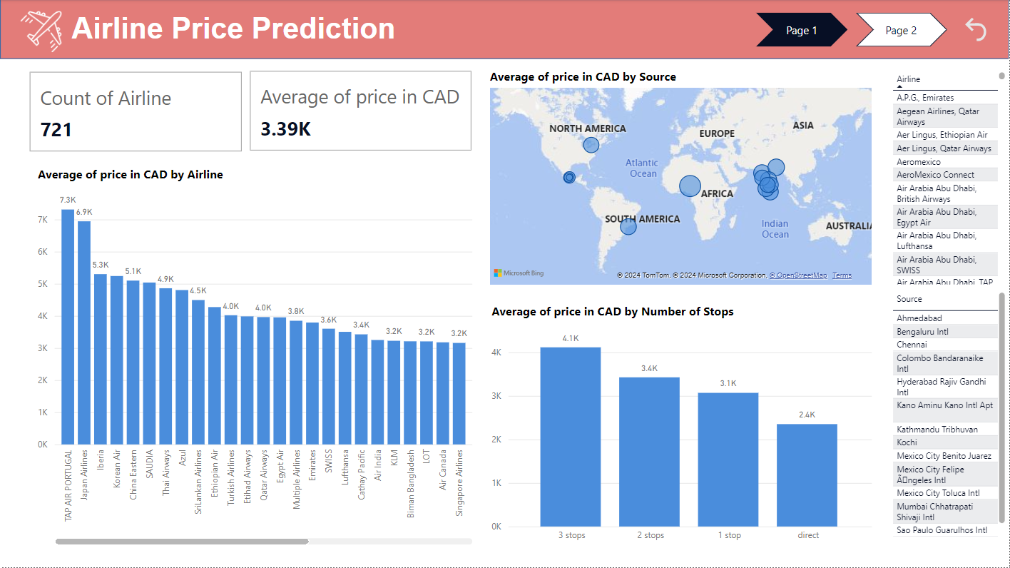
Dashboard PowerBI / New Dataset

Slide 22
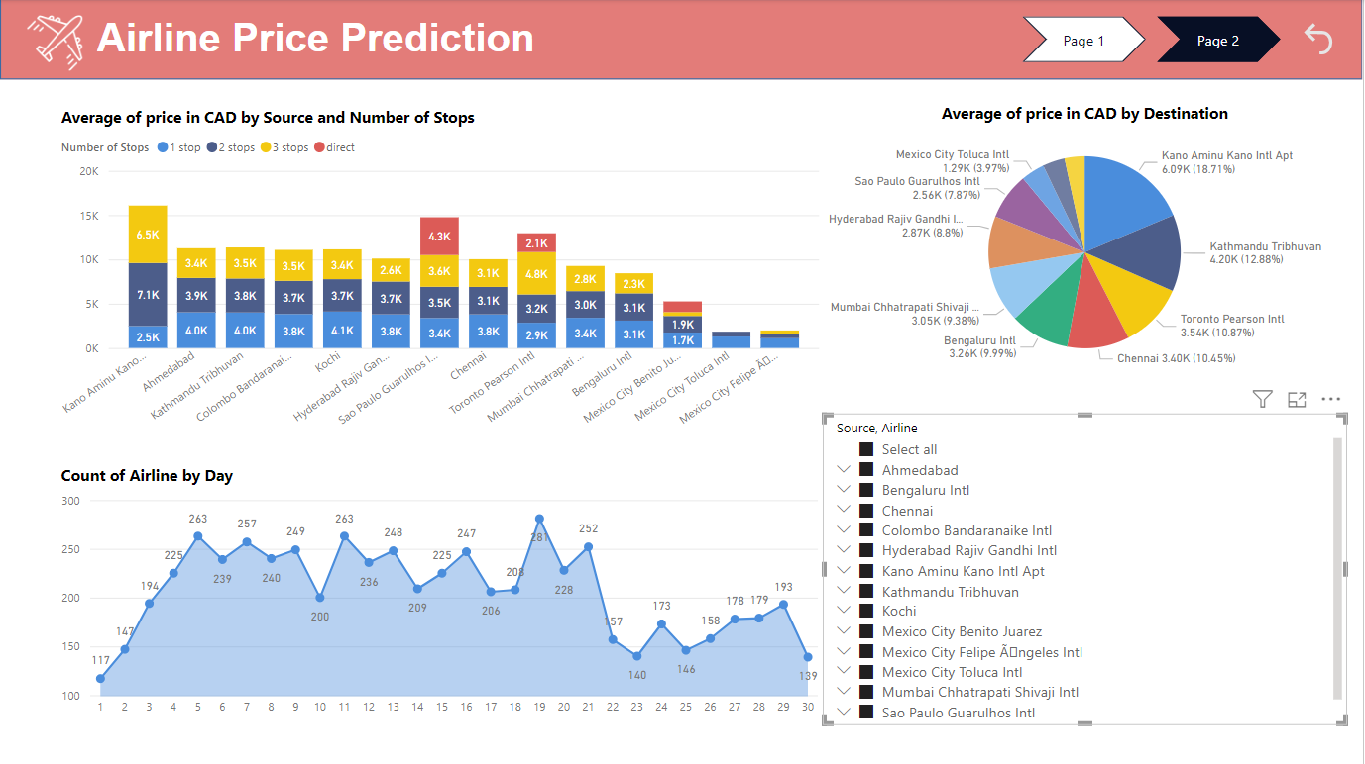
Dashboard PowerBI

Slide 23

Feature Engineering
Model Development
Model Evaluation
Dashboard Development
Deployment

Slide 24



